Slide 1
ITIL
How can we operate our IT systems better?
Lee Ji Hyun

Slide 2
Motivation

Slide 3
Operation?
Easy
Boring
Just Do it
Maybe someone will do.

Slide 4
I think..
We are developers and also operators.
We are already doing a lot of work for the operation.
We are put a lot of effort into improving development skill.
But.. development and operation are not the same.

Slide 5
Think about it
What is good operation?
How can we operate our IT systems better?

Slide 6
ITIL

Slide 7
IT service management (ITSM)
IT service management (ITSM) refers to the entirety of activities – directed by policies, organized and structured in processes and supporting procedures – that are performed by an organization to design, plan, deliver, operate and control information technology (IT) services offered to customers. It is thus concerned with the implementation of IT services that meet customers' needs, and it is performed by the IT service provider through an appropriate mix of people, process and information technology.
Notes:
ITSM(IT서비스 관리)는 조직이 고객에게 제공하는 정보 기술(IT)서비스를 설계, 계획, 제공, 운영 및 제어하기 위해 수행하는 정책, 조직화 및 프로세스 및 지원 절차에 따른 전체 작업을 말합니다. 따라서 이는 고객의 요구를 충족하는 IT서비스 구현과 관련이 있으며, 적절한 인력, 프로세스 및 정보 기술의 조합을 통해 IT서비스 공급 업체에 의해 수행됩니다

Slide 8
Information Technology Infrastructure Library (ITIL)
ITIL was started in the 1980's when the IT services provided to the British government did not meet expectations, and a method had to be found to achieve better quality at lower costs.
In 1989, ITIL v1 was published.
In 2001, ITIL v2 was published.
In 2007, ITIL v3 was published.
In 2011, the 2011 edition of ITIL v3 was published

Slide 9
Information Technology Infrastructure Library (ITIL)
ITIL (Information Technology Infrastructure Library) is a set of detailed practices for IT service management (ITSM) that focuses on aligning IT services with the needs of business.
Processes
Roles
Key Performance Indicators (KPIs)
Templates and Checklists

Slide 10
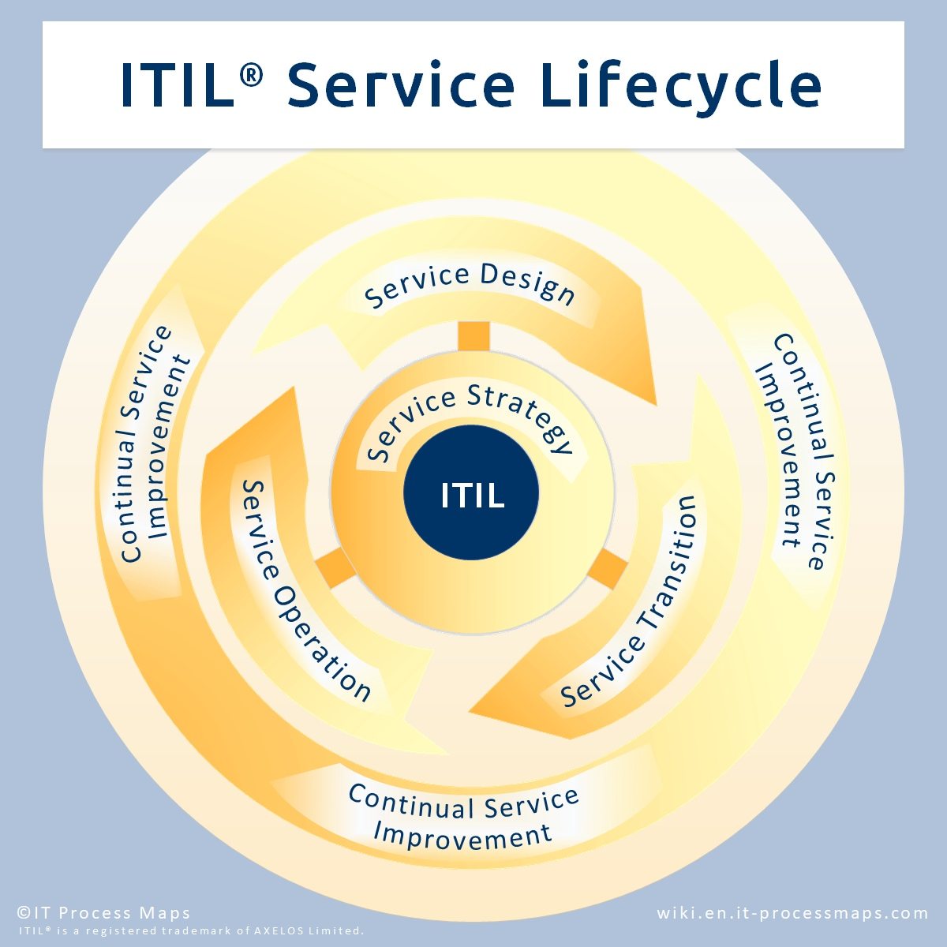
ITIL Service Lifecycle
Service Strategy
Service Design
Service Transition
Service Operation
Continual Service Improvement
Notes:
The ITIL processes within IT Service Management (ITSM) ensure that IT Services are provided in a focused, client-friendly and cost-optimized manner. With their help, IT Services are clearly defined, success can be measured with regards to the service provision, and targeted improvement measures can be introduced where necessary.

Slide 11
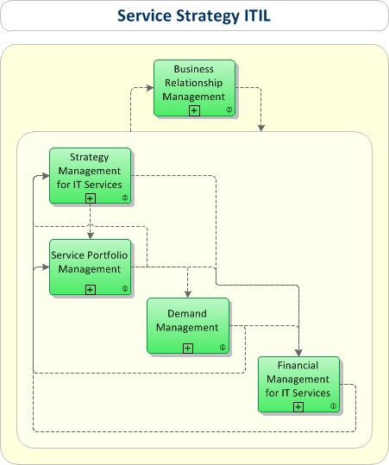
Processes: Service Strategy understands organizational objectives and customer needs
Strategy Management for IT Services
Service Portfolio Management
Financial Management for IT Services
Demand Management
Business Relationship Management
Notes:
Strategy Management for IT ServicesProcess Objective: To assess the service provider's offerings, capabilities, competitors as well as current and potential market spaces in order to develop a strategy to serve customers. Once the strategy has been defined, Strategy Management for IT Services is also responsible for ensuring the implementation of the strategy.
Service Portfolio ManagementProcess Objective: To manage the service portfolio. Service Portfolio Management ensures that the service provider has the right mix of services to meet required business outcomes at an appropriate level of investment.
Financial Management for IT ServicesProcess Objective: To manage the service provider's budgeting, accounting and charging requirements.
Demand ManagementProcess Objective: To understand, anticipate and influence customer demand for services. Demand Management works with Capacity Management to ensure that the service provider has sufficient capacity to meet the required demand.
Business Relationship ManagementProcess Objective: To maintain a positive relationship with customers. Business Relationship Management identifies the needs of existing and potential customers and ensures that appropriate services are developed to meet those needs.

Slide 12
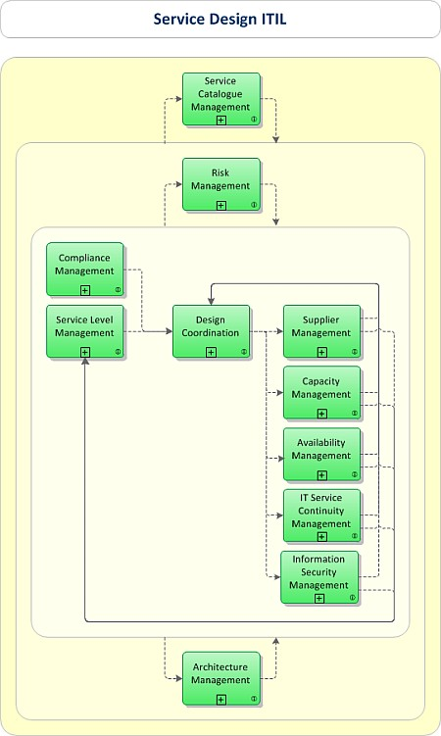
Processes: Service Design turns the service strategy into a plan for delivering the business objectives
Design coordination
Service catalogue management
Service level management
Risk Management
Capacity management
Availability management
IT service continuity management
Security management
Compliance Management
Supplier management
Notes:
Design CoordinationProcess Objective: To coordinate all service design activities, processes and resources. Design coordination ensures the consistent and effective design of new or changed IT services, service management information systems, architectures, technology, processes, information and metrics.
Service Catalogue ManagementProcess Objective: To ensure that a Service Catalogue is produced and maintained, containing accurate information on all operational services and those being prepared to be run operationally. Service Catalogue Management provides vital information for all other Service Management processes: Service details, current status and the services' interdependencies.
Service Level ManagementProcess Objective: To negotiate Service Level Agreements with the customers and to design services in accordance with the agreed service level targets. Service Level Management is also responsible for ensuring that all Operational Level Agreements and Underpinning Contracts are appropriate, and to monitor and report on service levels.
Risk ManagementProcess Objective: To identify, assess and control risks. This includes analyzing the value of assets to the business, identifying threats to those assets, and evaluating how vulnerable each asset is to those threats.
Capacity ManagementProcess Objective: To ensure that the capacity of IT services and the IT infrastructure is able to deliver the agreed service level targets in a cost effective and timely manner. Capacity Management considers all resources required to deliver the IT service, and plans for short, medium and long term business requirements.
Availability ManagementProcess Objective: To define, analyze, plan, measure and improve all aspects of the availability of IT services. Availability Management is responsible for ensuring that all IT infrastructure, processes, tools, roles etc. are appropriate for the agreed availability targets.
IT Service Continuity ManagementProcess Objective: To manage risks that could seriously impact IT services. ITSCM ensures that the IT service provider can always provide minimum agreed Service Levels, by reducing the risk from disaster events to an acceptable level and planning for the recovery of IT services. ITSCM should be designed to support Business Continuity Management.
Information Security ManagementProcess Objective: To ensure the confidentiality, integrity and availability of an organization's information, data and IT services. Information Security Management usually forms part of an organizational approach to security management which has a wider scope than the IT Service Provider.
Compliance ManagementProcess Objective: To ensure IT services, processes and systems comply with enterprise policies and legal requirements.
Architecture ManagementProcess Objective: To define a blueprint for the future development of the technological landscape, taking into account the service strategy and newly available technologies.
Supplier ManagementProcess Objective: To ensure that all contracts with suppliers support the needs of the business, and that all suppliers meet their contractual commitments.

Slide 13
Service Design - Availability Management To define, analyze, plan, measure and improve all aspects of the availability of IT services
Availability management addresses the ability of an IT component to perform at an agreed level over a period of time.
Reliability: Ability of an IT component to perform at an agreed level at described conditions.
Maintainability: The ability of an IT component to remain in, or be restored to an operational state.
Serviceability: The ability for an external supplier to maintain the availability of component or function under a third-party contract.
Resilience: A measure of freedom from operational failure and a method of keeping services reliable. One popular method of resilience is redundancy.
Security: A service may have associated data. Security refers to the confidentiality, integrity, and availability of that data. Availability gives a clear overview of the end-to-end availability of the system.
Notes:
가용성 관리는 일정 기간 동안 합의 된 수준에서 IT 구성 요소가 수행 할 수있는 기능을 처리합니다.
신뢰성 : 설명 된 조건에서 합의 된 수준에서 수행 할 IT 구성 요소의 기능.
유지 관리 가능성 : IT 구성 요소가 운영 상태로 유지되거나 운영 상태로 복원 될 수있는 기능.
서비스 가능성 : 외부 공급 업체가 타사 계약에 따라 구성 요소 또는 기능의 가용성을 유지할 수있는 기능.
탄력성 (Resilience) : 운영 실패로부터 자유로울 수있는 방법과 서비스를 신뢰할 수있는 방법. 탄력성의 한 가지 인기있는 방법은 중복성입니다.
보안 : 서비스가 관련 데이터를 가지고있을 수 있습니다. 보안이란 해당 데이터의 기밀성, 무결성 및 가용성을 말합니다. 가용성은 시스템의 엔드 투 엔드 가용성에 대한 명확한 개요를 제공합니다.

Slide 14
Service Design - IT Service Continuity Management To manage risks that could seriously impact IT services
ITSCM(IT Service Continuity Management) involves the following basic steps:
prioritising the activities to be recovered by conducting a business impact analysis (BIA)
performing a risk assessment (aka risk analysis) for each of the IT services to identify the assets, threats, vulnerabilities and countermeasures for each service.
evaluating the options for recovery
producing the contingency plan
testing, reviewing, and revising the plan on a regular basis.

Slide 15
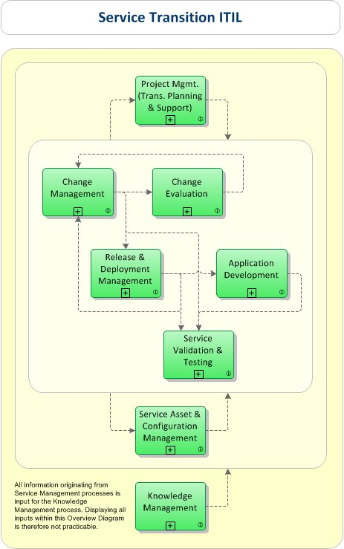
Processes: Service Transition develops and improves capabilities for introducing new services into supported environments.
Transition planning and support
Change management
Service asset and configuration management
Release and deployment management
Application Development
Service validation and testing
Change evaluation
Knowledge management
Notes:
Change ManagementProcess Objective: To control the lifecycle of all Changes. The primary objective of Change Management is to enable beneficial Changes to be made, with minimum disruption to IT services.
Change EvaluationProcess Objective: To assess major Changes, like the introduction of a new service or a substantial change to an existing service, before those Changes are allowed to proceed to the next phase in their lifecycle.
Project Management (Transition Planning and Support)Process Objective: To plan and coordinate the resources to deploy a major Release within the predicted cost, time and quality estimates.
Application DevelopmentProcess Objective: To make available applications and systems which provide the required functionality for IT services. This process includes the development and maintenance of custom applications as well as the customization of products from software vendors.
Release and Deployment ManagementProcess Objective: To plan, schedule and control the movement of releases to test and live environments. The primary goal of Release Management is to ensure that the integrity of the live environment is protected and that the correct components are released.
Service Validation and TestingProcess Objective: To ensure that deployed Releases and the resulting services meet customer expectations, and to verify that IT operations is able to support the new service.
Service Asset and Configuration ManagementProcess Objective: To maintain information about Configuration Items required to deliver an IT service, including their relationships.
Knowledge ManagementProcess Objective: To gather, analyze, store and share knowledge and information within an organization. The primary purpose of Knowledge Management is to improve efficiency by reducing the need to rediscover knowledge.

Slide 16
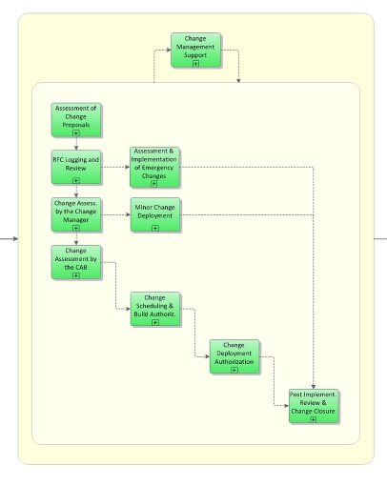
Service Transition - Change Management To control the lifecycle of all Changes
Notes:
Change Management Support
Process Objective: To provide templates and guidance for the authorization of Changes, and to supply the other IT Service Management processes with information on planned and ongoing Changes.
Assessment of Change Proposals
Process Objective: To asses Change Proposals which are typically submitted for significant Changes by Service Strategy. The purpose of assessing Change Proposals is to identify possible issues prior to the start of design activities.
RFC Logging and Review
Process Objective: To filter out Requests for Change which do not contain all information required for assessment or which are deemed impractical.
Assessment and Implementation of Emergency Changes
Process Objective: To assess, authorize and implement an Emergency Change as quickly as possible. This process is invoked if normal Change Management procedures cannot be applied because an emergency requires immediate action.
Change Assessment by the Change Manager
Process Objective: To determine the required level of authorization for the assessment of a proposed Change. Significant Changes are passed on to the CAB for assessment, while minor Changes are immediately assessed and authorized by the Change Manager.
Change Assessment by the CAB
Process Objective: To assess a proposed Change and authorize the Change planning phase. If required, higher levels of authority (e.g. IT Management) are involved in the authorization process.
Change Scheduling and Build Authorization
Process Objective: To authorize detailed Change and Release planning, and to assess the resulting Project Plan prior to authorizing the Change Build phase.
Change Deployment Authorization
Process Objective: To assess if all required Change components have been built and properly tested, and to authorize the Change Deployment phase.
Minor Change Deployment
Process Objective: To implement low-risk, well-understood Changes which do not require the involvement of Release Management.
Post Implementation Review and Change Closure
Process Objective: To assess the course of the Change implementation and the achieved results, in order to verify that a complete history if activities is present for future reference, and to make sure that any mistakes are analyzed and lessons learned.

Slide 17
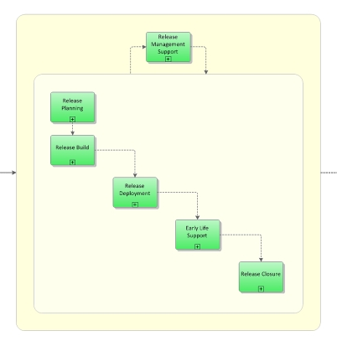
Service Transition - Release and Deployment Management To plan, schedule and control the movement of releases to test and live environments.
Notes:
Release Management Support
Process Objective: To provide guidelines and support for the deployment of Releases.
Release Planning
Process Objective: To assign authorized Changes to Release Packages and to define the scope and content of Releases. Based on this information, the Release Planning process develops a schedule for building, testing and deploying the Release.
Release Build
Process Objective: To issue all necessary Work Orders and Purchase Requests so that Release components are either bought from outside vendors or developed/ customized in-house. At the end of this process, all required Release components are ready to enter the testing phase.
Release Deployment
Process Objective: To deploy the Release components into the live production environment. This process is also responsible for training end-users and operating staff and circulating information/ documentation on the newly deployed Release or the services it supports.
Early Life Support
Process Objective: To resolve operational issues quickly during an initial period after Release deployment, and to remove any remaining errors or deficiencies.
Release Closure
Process Objective: To formally close a Release after verifying if activity logs and CMS contents are up to date.

Slide 18
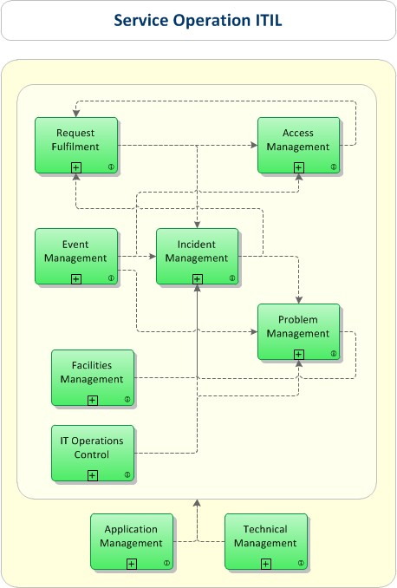
Processes: Service Operation manages services in supported environments
Event Management
Incident Management
Request Fulfilment
Access Management
Problem Management
IT Operations Control
Facilities Management
Application Management
Technical Management
Notes:
Event ManagementProcess Objective: To make sure CIs and services are constantly monitored, and to filter and categorize Events in order to decide on appropriate actions.
Incident ManagementProcess Objective: To manage the lifecycle of all Incidents. The primary objective of Incident Management is to return the IT service to users as quickly as possible.
Request FulfilmentProcess Objective: To fulfill Service Requests, which in most cases are minor (standard) Changes (e.g. requests to change a password) or requests for information.
Access ManagementProcess Objective: To grant authorized users the right to use a service, while preventing access to non-authorized users. The Access Management processes essentially execute policies defined in Information Security Management. Access Management is sometimes also referred to as Rights Management or Identity Management.
Problem ManagementProcess Objective: To manage the lifecycle of all Problems. The primary objectives of Problem Management are to prevent Incidents from happening, and to minimize the impact of incidents that cannot be prevented. Proactive Problem Management analyzes Incident Records, and uses data collected by other IT Service Management processes to identify trends or significant Problems.
IT Operations ControlProcess Objective: To monitor and control the IT services and their underlying infrastructure. The process IT Operations Control executes day-to-day routine tasks related to the operation of infrastructure components and applications. This includes job scheduling, backup and restore activities, print and output management, and routine maintenance.
Facilities ManagementProcess Objective: To manage the physical environment where the IT infrastructure is located. Facilities Management includes all aspects of managing the physical environment, for example power and cooling, building access management, and environmental monitoring.
Application ManagementApplication Management is responsible for managing applications throughout their lifecycle.
Technical ManagementTechnical Management provides technical expertise and support for the management of the IT infrastructure.

Slide 19
Service Operation - Event Management To make sure CIs and services are constantly monitored, and to filter and categorize Events in order to decide on appropriate actions.
Maintenance of Event Monitoring Mechanisms and Rules
Process Objective: To set up and maintain the mechanisms for generating meaningful Events and effective rules for their filtering and correlating.
Event Filtering and 1st Level Correlation
Process Objective: To filter out Events which are merely informational and can be ignored, and to communicate any Warning and Exception Events.
2nd Level Correlation and Response Selection
Process Objective: To interpret the meaning of an Event and select a suitable response if required.
Event Review and Closure
Process Objective: To check if Events have been handled appropriately and may be closed. This process also makes sure that Event logs are analyzed in order to identify trends or patterns which suggest corrective action must be taken.
Notes:
Maintenance of Event Monitoring Mechanisms and Rules
Process Objective: To set up and maintain the mechanisms for generating meaningful Events and effective rules for their filtering and correlating.
Event Filtering and 1st Level Correlation
Process Objective: To filter out Events which are merely informational and can be ignored, and to communicate any Warning and Exception Events.
2nd Level Correlation and Response Selection
Process Objective: To interpret the meaning of an Event and select a suitable response if required.
Event Review and Closure
Process Objective: To check if Events have been handled appropriately and may be closed. This process also makes sure that Event logs are analyzed in order to identify trends or patterns which suggest corrective action must be taken.

Slide 20
Service Operation - Incident Management To manage the lifecycle of all Incidents. The primary objective of Incident Management is to return the IT service to users as quickly as possible.
Incident Management Support
Incident Logging and Categorization
Immediate Incident Resolution by 1st Level Support
Incident Resolution by 2nd Level Support
Handling of Major Incidents
Incident Monitoring and Escalation
Incident Closure and Evaluation
Pro-Active User Information
Incident Management Reporting
Notes:
Incident Management Support
Process Objective: ITIL Incident Management Support aims to provide and maintain the tools, processes, skills and rules for an effective and efficient handling of Incidents.
Incident Logging and Categorization
Process Objective: To record and prioritize the Incident with appropriate diligence, in order to facilitate a swift and effective resolution.
Immediate Incident Resolution by 1st Level Support
Process Objective: To solve an Incident (service interruption) within the agreed time schedule. The aim is the fast recovery of the IT service, where necessary with the aid of a Workaround. As soon as it becomes clear that 1st Level Support is not able to resolve the Incident itself or when target times for 1st level resolution are exceeded, the Incident is transferred to a suitable group within 2nd Level Support.
Incident Resolution by 2nd Level Support
Process Objective: To solve an Incident (service interruption) within the agreed time schedule. The aim is the fast recovery of the service, where necessary by means of a Workaround. If required, specialist support groups or third-party suppliers (3rd Level Support) are involved. If the correction of the root cause is not possible, a Problem Record is created and the error-correction transferred to Problem Management.
Handling of Major Incidents
Process Objective: To resolve a Major Incident. Major Incidents cause serious interruptions of business activities and must be resolved with greater urgency. The aim is the fast recovery of the service, where necessary by means of a Workaround. If required, specialist support groups or third-party suppliers (3rd Level Support) are involved. If the correction of the root cause is not possible, a Problem Record is created and the error-correction transferred to Problem Management.
Incident Monitoring and Escalation
Process Objective: To continuously monitor the processing status of outstanding Incidents, so that counter-measures may be introduced as soon as possible if service levels are likely to be breached.
Incident Closure and Evaluation
Process Objective: To submit the Incident Record to a final quality control before it is closed. The aim is to make sure that the Incident is actually resolved and that all information required to describe the Incident's life-cycle is supplied in sufficient detail. In addition to this, findings from the resolution of the Incident are to be recorded for future use.
Pro-Active User Information
Process Objective: To inform users of service failures as soon as these are known to the Service Desk, so that users are in a position to adjust themselves to interruptions. Proactive user information also aims to reduce the number of inquiries by users. This process is also responsible for distributing other information to users, e.g. security alerts.
Incident Management Reporting
Process Objective: ITIL Incident Management Reporting aims to supply Incident-related information to the other Service Management processes, and to ensure that that improvement potentials are derived from past Incidents.

Slide 21
Service Operation - Problem Management To manage the lifecycle of all Problems
Proactive Problem Identification
Problem Categorization and Prioritization
Problem Diagnosis and Resolution
Problem and Error Control
Problem Closure and Evaluation
Major Problem Review
Problem Management Reporting
Notes:
Proactive Problem Identification
Process Objective: To improve overall availability of services by proactively identifying Problems. Proactive Problem Management aims to identify and solve Problems and/or provide suitable Workarounds before (further) Incidents recur.
Problem Categorization and Prioritization
Process Objective: To record and prioritize the Problem with appropriate diligence, in order to facilitate a swift and effective resolution.
Problem Diagnosis and Resolution
Process Objective: To identify the underlying root cause of a Problem and initiate the most appropriate and economical Problem solution. If possible, a temporary Workaround is supplied.
Problem and Error Control
Process Objective: To constantly monitor outstanding Problems with regards to their processing status, so that where necessary corrective measures may be introduced.
Problem Closure and Evaluation
Process Objective: To ensure that - after a successful Problem solution - the Problem Record contains a full historical description, and that related Known Error Records are updated.
Major Problem Review
Process Objective: To review the resolution of a Problem in order to prevent recurrence and learn any lessons for the future. Furthermore it is to be verified whether the Problems marked as closed have actually been eliminated.
Problem Management Reporting
Process Objective: ITIL Problem Management Reporting aims to ensure that the other Service Management processes as well as IT Management are informed of outstanding Problems, their processing-status and existing Workarounds (see "Problem Management Report").

Slide 22
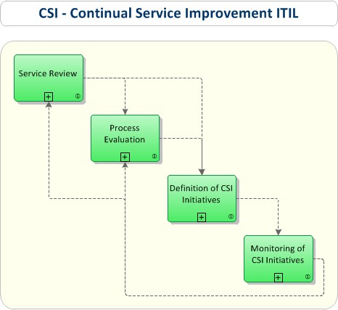
Processes: Continual Service Improvement achieves services incremental and large-scale improvements
Service Review
Process Evaluation
Definition of CSI Initiatives
Monitoring of CSI Initiatives
Notes:
Service ReviewProcess Objective: To review business services and infrastructure services on a regular basis. The aim of this process is to improve service quality where necessary, and to identify more economical ways of providing a service where possible.
Process EvaluationProcess Objective: To evaluate processes on a regular basis. This includes identifying areas where the targeted process metrics are not reached, and holding regular benchmarkings, audits, maturity assessments and reviews.
Definition of CSI InitiativesProcess Objective: To define specific initiatives aimed at improving services and processes, based on the results of service reviews and process evaluations. The resulting initiatives are either internal initiatives pursued by the service provider on his own behalf, or initiatives which require the customer’s cooperation.
Monitoring of CSI InitiativesProcess Objective: To verify if improvement initiatives are proceeding according to plan, and to introduce corrective measures where necessary.

Slide 23
Conclusion

Slide 24
Maybe..
It wouldn't have been funny.
Feel out of place with us.
Feel it’s too old style.
You don't have to do this.
I’m also not much of a very professional about this.
But I think it'll be better if you think about it once.
Because in fact, a lot of IT-systems are operated like this way.

Slide 25
Link
ITSM Softwares
https://www.capterra.com/itsm-software/?utf8=%E2%9C%93&users=&sort_options=Highest+Rated
Using JIRA as an Information Technology Infrastructure Library (ITIL)
https://confluence.atlassian.com/jirakb/using-jira-as-an-information-technology-infrastructure-library-itil-298978148.html
Using JIRA to support ITIL processes
https://martinskemme.wordpress.com/2009/02/01/using-jira-to-support-itil-processes/

Slide 26
Reference
https://wiki.en.it-processmaps.com/index.php/Main_Page
https://en.m.wikipedia.org/wiki/ITIL

Slide 27
Thank you

